Slide 1
Uncertainty
CHAPTER 13
Oliver Schulte
Summer 2011
Notes:
Outline
Random variables.
Joint distribuiton.
Probability calculus.
Marginalization.
Conditional probabilities.
Product rule.
These two go into next lecture.
Bayes’ theorem.
Independence.
Maybe try this: show examples of every rule in Bayes net. So just do joint distribution and marginalization first. Then do independence and conditional independence using a Bayes net example.

Slide 2
Environments with Uncertainty
Fully Observable
yes
no
Deterministic
no
yes
Certainty: Search
Uncertainty
Artificial Intelligence a modern approach
Notes:
Comparison to game theory. How can you have full observability with nondeterminism? E.g. GPS system: knows its state, but doesn’t know whether driver will follow its instructions. Can argue philosophically that nondeterminism involves partial observability because there must be hidden factors that determine outcome.

Slide 3
Outline
Uncertainty and Rationality
Probability
Syntax and Semantics
Inference Rules

Slide 4
Motivation
In many cases, our perceptions are incomplete (not enough information) or uncertain (sensors are unreliable).
Rules about the domain are incomplete or admit exceptions.
Probabilistic knowledge
  Quantifies uncertainty.
  Supports rational decision-making.
Notes:
We have to act in spite of this!
Drawing conclusions under uncertainty.
Connections with Statistics, Economics.
AI has developed other approaches to uncertainty, not covered in this course.
Recall early discussion about intelligent action.

Slide 5
Probability and Rationality

Slide 6
Review: Rationality
Rational is different from omniscience
  Percepts may not supply all relevant information.
Rational is different from being perfect
  Rationality maximizes expected outcome while perfection maximizes actual outcome.
Probability
Utility
Expected Utility
Artificial Intelligence a modern approach

Slide 7
Example
You want to take the skytrain home tonight. You have two options: pay $3.75 for a ticket, or don’t pay and run the risk of being fined $50.
Suppose you know that on average, Translink checks fares on a train 10% of the time. Should you pay the fare?
10%
90%
 | Check | Not Check
Pay Fare | -$3.75 | -$3.75
Not pay fare | 0 | -$50
Notes:
More examples in game theory part.
Other examples: invest in the stock market.
Believe in God?!

Slide 8
Making decisions under uncertainty
Suppose I believe the following:
  P(A₂₅ gets me there on time | …) = 0.04
  P(A₉₀ gets me there on time | …) = 0.70
  P(A₁₂₀ gets me there on time | …) = 0.95
  P(A₁₄₄₀ gets me there on time | …) = 0.9999
Depends on my preferences for missing flight vs. time spent waiting, etc.
The fundamental idea of decision theory is that an agent is rational if and only if it chooses the action that yields that highest expected utility, averaged over all the possible outcomes of the action.
Utility theory is used to represent and infer preferences
Decision theory = probability theory + utility theory
  Which action to choose? Which one is rational?

Slide 9
Probabilistic Knowledge

Slide 10
Uncertainty vs. Logical Rules
Cavity causes toothache.
Cavity is detected by probe (catches).
In logic:
  Cavity => Toothache.
    But not always, e.g.
    Cavity, dead nerve does not cause Toothache.
    Nonmonotonic rules: adding information changes conclusions.
  Cavity => CatchProbe.
    Also not always.
Notes:
Other examples: no logical rule for skytrain checks.
Logical entailment is deterministic: given that the conditions hold, the consequence must hold also.

Slide 11
Probability vs. Determinism
Medical diagnosis is not deterministic.
  Laziness: failure to enumerate exceptions, qualifications, etc.
  Theoretical ignorance: lack of relevant facts, initial conditions, etc.
  Practical ignorance: Even if we know all the rules, a patient might not have done all the necessary tests.
Probabilistic assertions summarize effects of
  Laziness
  Ignorance
Notes:
If we had complete knowledge, deterministic rules would be fine.
(Laplace 19th century).

Slide 12
Probability Syntax

Slide 13
Probability Syntax
Basic element: variable that can be assigned a value.
  Like CSP.
  Unlike 1st-order variables.
Boolean variables
  e.g., Cavity (do I have a cavity?)
Discrete variables
  e.g., Weather is one of <sunny,rainy,cloudy,snow>
Atom = assignment of value to variable.
  Aka etomic event. Examples:
  Weather = sunny
  Cavity = false.
Sentences are Boolean combinations of atoms.
  Same as propositional logic. Examples:
  Weather = sunny OR Cavity = false.
  Catch = true AND Tootache = False.
Notes:
Show how to graph in Bayes net.
Variable like CSP. Do table CSP vs. logic. Assignment of value to variable. Sentence: Boolean combination of assignments= boolean combination of literals. Example with 3 variables, cavity etc. Proposition = set of possible worlds. Random variable example.
Sentences are also called events or propositions, more soon.
Can also have continuous variables (not covered).
Don’t confuse probabilistic variables with 1st-order variables.

Slide 14
Probabilities and Possible Worlds
Possible World: A complete assignment of a value to each variable.
Removes all uncertainty.
Event or proposition = set of possible worlds.
Atomic event = a single possible world.
Logic | Statistics | Examples
n/a | Variable | Weather, Cavity, Probe, Toothache
Atom | Variable Assignment | Weather = sunny Cavity = false
Possible World | Atomic Event | [Weather = sunny Cavity = false Catch = false Toothache = true]
Notes:
Give example of possible world in Bayes net.
Atomic events are
mutually exclusive: at most one is true
Exhaustive: at least one is true

Slide 15
Random Variables
A random variable has a probability associated with each of its values.
Variable | Value | Probability
Weather | Sunny | 0.7
Weather | Rainy | 0.2
Weather | Cloudy | 0.08
Weather | Snow | 0.02
Cavity | True | 0.2
Cavity | False | 0.8
Notes:
Fill in Cavity value later

Slide 16
Probability for Sentences
Sentences also have probabilities assigned to them.
Sentence | Probability
P(Cavity = false AND Toothache = false) | 0.72
P(Cavity = true OR Toothache = false) | 0.08
Notes:
Use sentences that are used later.
2nd sentence should have higher probability.
Exercise: Prove that if A entails B, then P(A) >= P(B).

Slide 17
Probability Notation
Often probability theorists write A,B instead of A ∧ B (like Prolog).
If the intended random variables are known, they are often not mentioned.
Shorthand | Full Notation
P(Cavity = false,Toothache = false) | P(Cavity = false ∧Toothache = false)
P(false, false) | P(Cavity = false ∧Toothache = false)

Slide 18
The Joint Distribution

Slide 19

Assigning Probabilities to Sentences
The joint probability distribution specifies the probability of each possible world (atomic event).
A joint distribution determines an probability for every sentence.
How? Spot the pattern.
Notes:
Give examples: P(toothache, not cavity, toothache or cavity, as needed before).

Slide 20
Probabilities for Sentences: Spot the Pattern
Sentence | Probability
P(Cavity = false AND Toothache = false) | 0.72
P(Cavity = true OR Toothache = false) | 0.08
P(Toothache = false) | 0.8

Slide 21

Inference by enumeration

Slide 22
Inference by enumeration
Marginalization: For any sentence A, sum the atomic events (possible worlds) where A is true.
P(toothache) = 0.108 + 0.012 + 0.016 + 0.064 = 0.2.
Compare with logical inference by model checking.

Slide 23
Probabilistic Inference Rules
Notes:
Logic: rewrite rules: infer new sentences from previous ones.
Probability: infer new probabilities from previous ones.
---
Assignment prove 1- rule,
prove that entailment means lower probability.

Slide 24
Inference by enumeration
The joint probability distribution specifies the probability of each possible world (atomic event).
Marginalization: For any proposition φ, sum the atomic events (possible worlds) where it is true.

Slide 25
Inference by enumeration
Start with the joint probability distribution:
Marginalization: For any proposition φ, sum the atomic events (possible worlds) where it is true.
P(toothache) = 0.108 + 0.012 + 0.016 + 0.064 = 0.2.
Compare with inference by model checking.

Slide 26

Inference by enumeration
Start with the joint probability distribution:
Marginalization: For any proposition φ, sum the atomic events (possible worlds) where it is true.
P(toothache or cavity) = 0.108 + 0.012 + 0.016 + 0.064 +0.072 + 0.008 = 0.28

Slide 27
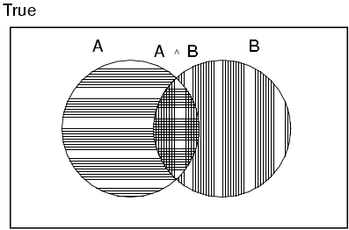
Axioms of probability
For any formula A, B
  P(true) = 1 and P(false) = 0
  P(A ∨ B) =
  P(A) + P(B) - P(A ∧ B)
0 ≤ P(A) ≤ 1
Formulas considered as sets of possible worlds.
Notes:
Logical equivalence connects probability and logic.
“True” is a constant sentence that is true in all possible worlds.

Slide 28
Rule 1: Logical Equivalence
P(NOT (NOT Cavity)) | P(Cavity)
0.2 | 0.2
P(NOT (Cavity AND Toothache)) | P(Cavity = F OR Toothache = F)
0.88 | 0.88
P(NOT (Cavity OR Toothache) | P(Cavity = F AND Toothache = F)
0.72 | 0.72
Notes:
Spot the pattern

Slide 29
The Logical Equivalence Pattern
P(NOT (NOT Cavity)) | = | P(Cavity)
0.2 |  | 0.2
Rule 1: Logically equivalent expressions have the same probability.
P(NOT (Cavity AND Toothache)) | = | P(Cavity = F OR Toothache = F)
0.88 |  | 0.88
P(NOT (Cavity OR Toothache) | = | P(Cavity = F AND Toothache = F)
0.72 |  | 0.72
Notes:
This shows how logical reasoning is an important part of probabilistic reasoning.
Often easier to determine probability after transforming expression into a logically equivalent form.

Slide 30
Rule 2: Marginalization
P(Cavity, Toothache) | P(Cavity, Toothache = F) | P(Cavity)
0.12 | 0.08 | 0.2
P(Cavity = F, Toothache) | P(Cavity = F, Toothache = F) | P(Cavity = F)
0.08 | 0.72 | 0.8
P(Cavity, Toothache) | P(Cavity = F, Toothache) | P(Toothache)
0.12 | 0.08 | 0.2
Notes:
Assignment: fill in marginal over 2 variables.

Slide 31
The Marginalization Pattern
P(Cavity, Toothache) | + | P(Cavity, Toothache = F) | = | P(Cavity)
0.12 |  | 0.08 |  | 0.2
P(Cavity = F, Toothache) | + | P(Cavity = F, Toothache = F) | = | P(Cavity = F)
0.08 |  | 0.72 |  | 0.8
P(Cavity, Toothache) | + | P(Cavity = F, Toothache) | = | P(Toothache)
0.12 |  | 0.08 |  | 0.2
Notes:
Assignment: fill in marginal over 2 variables.

Slide 32
Prove the Pattern: Marginalization
Theorem. P(A) = P(A,B) + P(A, not B)
Proof.
A is logically equivalent to
[A and B) ∨ (A and not B)].
P(A) = P([A and B) ∨ (A and not B)]) =
P(A and B) + P(A and not B) –
P([A and B) ∧ (A and not B)]). Disjunction Rule.
[A and B) ∧ (A and not B)] is logically equivalent to false, so P([A and B) ∧ (A and not B)]) =0.
So 2. implies P(A) = P(A and B) + P(A and not B).

Slide 33
Conditional Probabilities: Intro
Given (A) that a die comes up with an odd number, what is the probability that (B) the number is
  a 2
  a 3
Answer: the number of cases that satisfy both A and B, out of the number of cases that satisfy A.
Examples:
  #faces with (odd and 2)/#faces with odd
  = 0 / 3 = 0.
  #faces with (odd and 3)/#faces with odd
  = 1 / 3.

Slide 34
Conditional Probs ctd.
Suppose that 50 students are taking 310 and 30 are women. Given (A) that a student is taking 310, what is the probability that (B) they are a woman?
Answer:
#students who take 310 and are a woman/
#students in 310
= 30/50 = 3/5.
Notation: P(A|B)

Slide 35
Conditional Ratios: Spot the Pattern
Spot the Pattern
P(die comes up with odd number) | P(die comes up with 3) | P(3|odd number)
1/2 | 1/6 | 1/3
P(Student takes 310) | P(Student takes 310 and is woman) | P(Student is woman|Student takes 310)
=50/15,000 | 30/15,000 | 3/5

Slide 36
Conditional Probs: The Ratio Pattern
Spot the Pattern
P(die comes up with odd number) | / | P(die comes up with 3) | = | P(3|odd number)
1/2 |  | 1/6 |  | 1/3
P(Student takes 310) | / | P(Student takes 310 and is woman) | = | P(Student is woman|Student takes 310)
=50/15,000 |  | 30/15,000 |  | 3/5
P(A|B) = P(A and B)/ P(B) Important!
Notes:
Exercise: prove that conditioning leads to a well-defined normalized probability measure.

Slide 37
Conditional Probabilities: Motivation
From logical clauses: much knowledge can be represented as implications
B1,..,Bk =>A.
Conditional probabilities are a probabilistic version of reasoning about what follows from conditions.
Cognitive Science: Our minds store implicational knowledge.
Key for understanding Bayes nets.

Slide 38
The Product Rule: Spot the Pattern
P(Cavity) | P(Toothache|Cavity) | P(Cavity,Toothache)
0.2 | 0.6 | 0.12
P(Toothache) | P(Cavity| Toothache) | P(Cavity,Toothache)
0.2 | 0.6 | 0.12
P(Cavity =F) | P(Toothache|Cavity = F) | P(Toothache,Cavity =F)
0.8 | 0.1 | 0.08
P(Cavity =F) | x | P(Toothache|Cavity = F) | = | P(Toothache,Cavity =F)
0.8 |  | 0.1 |  | 0.08
Notes:
Product Rule: P(A,B) = P(A|B) x P(B)

Slide 39
The Product Rule Pattern
P(Cavity) | x | P(Toothache|Cavity) | = | P(Cavity,Toothache)
0.2 |  | 0.6 |  | 0.12
P(Toothache) | x | P(Cavity| Toothache) | = | P(Cavity,Toothache)
0.2 |  | 0.6 |  | 0.12
P(Cavity =F) | x | P(Toothache|Cavity = F) | = | P(Toothache,Cavity =F)
0.8 |  | 0.1 |  | 0.08
Notes:
Product Rule: P(A,B) = P(A|B) x P(B)

Slide 40
Exercise: Marginalization
Prove the marginalization principle
P(A) = P(A, B) + P(A, not B).

Slide 41
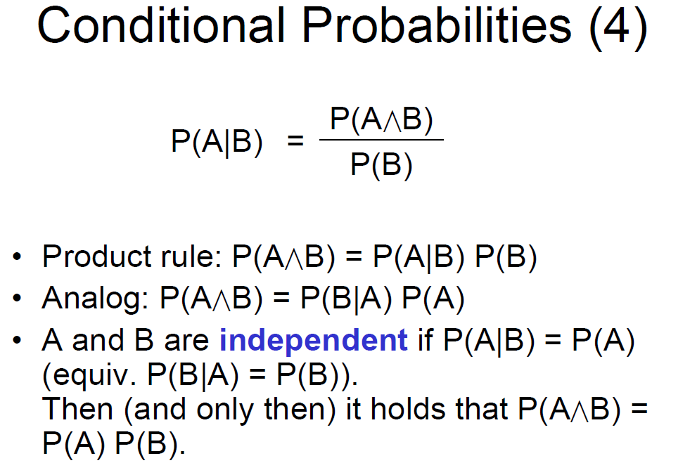

Slide 42
Exercise: Conditional Probability
Prove the product rule P(A,B) = P(A|B) x P(B).
  Marginal + conditional ➔ joint.
Two propositions A,B are independent if
P(A|B) = P(A). Prove that the following conditions are equivalent if P(A) > 0, P(B)> 0.
P(A|B) = P(A).
P(B|A) = P(B).
P(A,B) = P(A) x P(B).
Notes:
Solution:
1 or 2 -> 3: use product rule.
3 -> 1: P(A|B) = P(A,B)/P(B) = P(A) x P(B) / P(B) = P(A).

Slide 43
Why are the Axioms Reasonable?
If P represents an objectively observable probability, the axioms clearly make sense.
But why should an agent respect these axioms when it models its own degree of belief?
Objective vs. subjective probabilities
  The axioms limit the set of beliefs that an agent can maintain.
One of the most convincing arguments for why subjective beliefs should respect the axioms was put forward by de Finetti in 1931. It is based on the connection between actions and degree of belief.
  If the beliefs are contradictory, then the agent will fail in its environment in the long run!

Slide 44
The game
Player1 gives a subjective probability “a” on the occurrence of an event “b”
Player2 can then decide to bet either $“a” dollars against player1’s $“1-a” that b happens or $“1-a” dollars against player1 $“a” that b does happen
Which decision is more rational?
  To bet for b 0.4 *$60 - 0.6 *$40 = 0
  To bet against b 0.6 *$40 - 0.4 *$60 = 0
Player 2 bets $40 that “b”
player1 bets $60 that not b
P(b) = 0.4
Player 2 bets $60 that “b”
player1 Bets 40 dollar that not b

Slide 45

Why are the Axioms Reasonable?
Player1 bets $40 for a
Player2 bets $60 for a
P(a)= 0.4
P(b) = 0.3
P( ) = 0.8
Player1 bets $60 for a
Player2 bet $40 for a
Player1 bets $30 for b
Player2 bets $70 for b
Player1 bets $70 for b
Player2 bets $30 for b
Player1 bets $80 for ( )
Player2 bets $20 for ( )
Player1 bets $20 for ( )
Player2 bets $80 for ( )

Slide 46
Why are the Axioms Reasonable?
 | a , b | Not a, b | a, not b | Not a, not b
a | 6 | -4 | 6 | -4
b | 7 | 7 | -3 | -3
( ) | -2 | -2 | -2 | 8
 | 11 | 1 | 1 | 1

Slide 47

Inference by enumeration
Joint distribution ➔ marginals + conditionals
P(¬cavity | toothache) = P(¬cavity ∧ toothache)
P(toothache)
= 0.016+0.064 = 0.4
0.108 + 0.012 + 0.016 + 0.064

Slide 48
Normalization
P(¬cavity | toothache) = P(¬cavity ∧ toothache)
P(toothache)
P(cavity | toothache) = P(cavity ∧ toothache)
P(toothache)
Denominator can be viewed as a normalization constant α
P(Cavity | toothache) = α P(Cavity,toothache)
  = α [P(Cavity,toothache,catch) + P(Cavity,toothache,¬ catch)]
  = α [<0.108,0.016> + <0.012,0.064>]
  = α <0.12,0.08> = <0.6,0.4>
General idea: compute distribution on query variable by fixing evidence variables and summing over hidden variables

Slide 49
Inference by enumeration, contd.
Typically, we are interested in
the posterior joint distribution of the query variables Y
given specific values e for the evidence variables E
Let the hidden variables be H = X - Y – E
  P(Y | E = e) = αP(Y,E = e) = αΣ_{h}P(Y,E= e, H = h)
The terms in the summation are joint entries because Y, E and H together exhaust the set of random variables
  Worst-case time complexity O(d^{n}) where d is the largest arity
  Space complexity O(d^{n}) to store the joint distribution
  How to find the numbers for O(d^{n}) entries?
Obvious problems:
Then the required summation of joint entries is done by summing out the hidden variables:

Slide 50
Bayes’ Theorem
Exercise: Prove Bayes’ Theorem
P(A | B) = P(B | A) P(A) / P(B).

Slide 51
On Bayes’ Theorem
P(a | b) = P(b | a) P(a) / P(b).
Useful for assessing diagnostic probability from causal probability:
P(Cause|Effect) = _x000b_P(Effect|Cause) P(Cause) / P(Effect)._x000b_
Likelihood: how well does the cause explain the effect?
Prior: how plausible is the explanation before any evidence?
Normalization Constant: how surprising is the evidence?

Slide 52
Example for Bayes’ Theorem
P(Wumpus|Stench) =
P(Stench|Wumpus) x P(Wumpus) / P(Stench).
Is P(Wumpus[1,3]|Stench[1,2]) > P(Wumpus[1,3])?

Slide 53
Bayes’ Theorem: Another Example
A doctor knows that the disease meningitis causes the patient to have a stiff neck 50% of the time. The prior that someone has meningitis is 1/50000 and the prior that someone has a stiff neck is 1/20, knowing that a person has a stiff neck what is the probability that they have meningitis?

Slide 54
let M be meningitis, S be stiff neck:
  Note: posterior probability of meningitis still very small! One in every 5000
  Stiff neck a strong indication
Why not just store the number?
  Based on facts if we had epidemic we know how to update facts
P(m|s) = P(s|m) P(m) / P(s) = (0.5 × 1/50000 )/ (1/20)= 0.0002

Slide 55
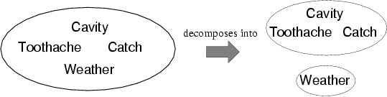
Independence
Suppose that Weather is independent of the Cavity Scenario. Then the joint distribution decomposes:
  P(Toothache, Catch, Cavity, Weather)
  = P(Toothache, Catch, Cavity) P(Weather)
Absolute independence powerful but rare
Dentistry is a large field with hundreds of variables, none of which are independent. What to do?

Slide 56
Conditional independence
If I have a cavity, the probability that the probe catches in it doesn't depend on whether I have a toothache:
  (1) P(catch | toothache, cavity) = P(catch | cavity)
The same independence holds if I haven't got a cavity:
(2) P(catch | toothache,¬cavity) = P(catch | ¬cavity)
Catch is conditionally independent of Toothache given Cavity:
P(Catch | Toothache,Cavity) = P(Catch | Cavity)
The equivalences for independence also holds for conditional independence, e.g.:
  P(Toothache | Catch, Cavity) = P(Toothache | Cavity)
  P(Toothache, Catch | Cavity) = P(Toothache | Cavity) P(Catch | Cavity)
Conditional independence is our most basic and robust form of knowledge about uncertain environments.

Slide 57
Conditional independence contd.
Write out full joint distribution using product rule:
P(Toothache, Catch, Cavity)
  = P(Toothache | Catch, Cavity) P(Catch, Cavity)
I.e., 2 + 2 + 1 = 5 independent numbers
In most cases, the use of conditional independence reduces the size of the representation of the joint distribution from exponential in n to linear in n.
Conditional independence is our most basic and robust form of knowledge about uncertain environments.
  = P(Toothache | Catch, Cavity) P(Catch | Cavity) P(Cavity)
  = P(Toothache | Cavity) P(Catch | Cavity) P(Cavity)

Slide 58
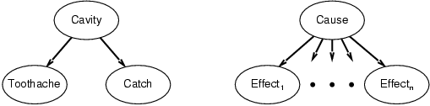
Bayes' Theorem and conditional independence
P(Cavity | toothache ∧ catch)
  = αP(toothache ∧ catch | Cavity) P(Cavity)/ p(toothache ∧ catch)
  = αP(toothache ∧ catch | Cavity) P(Cavity)
  = αP(toothache | Cavity) P(catch | Cavity) P(Cavity)
  P(Cause | Effect₁, … ,Effect_{n}) = α π_{i}P(Effect_{i}|Cause) P(Cause)
This is an example of a naïve Bayes model:
P(Cause,Effect1, … ,Effectn) = P(Cause) πiP(Effecti|Cause)
Total number of parameters is linear in n

Slide 59
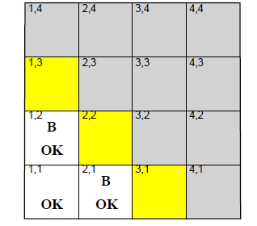
Wumpus World
Let’s define the random variables first
  P_{ij} = true if [i,j] contains a pit
  B_{ij} = true if [i,j] is breezy
  We want to be able to predict the probability of possbile boards

Slide 60
Specifying the probability model
P
P
P
P
P
P
P
=0
=1

Slide 61
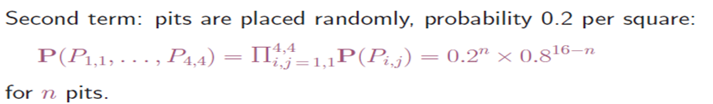
P
P
P
P
= 0.2⁴ × 0.8¹²

Slide 62
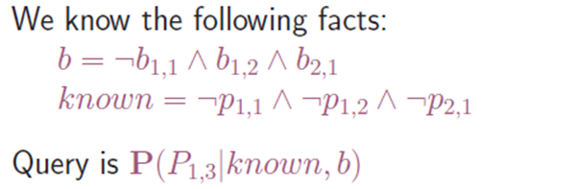
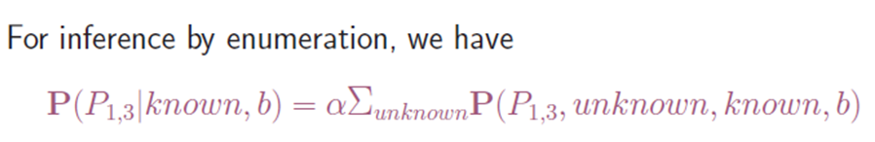
P?
Done?
Unknown has 12 squares. 2 ¹² = 4096
Is P₁₃ really related to P₄₄?

Slide 63
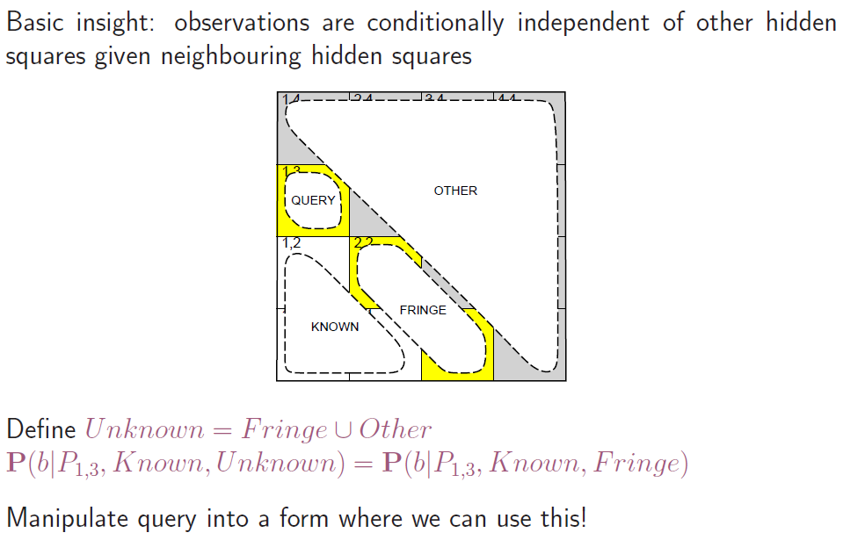
Using conditional independence

Slide 65

1

Slide 66
=0
=1

Slide 67
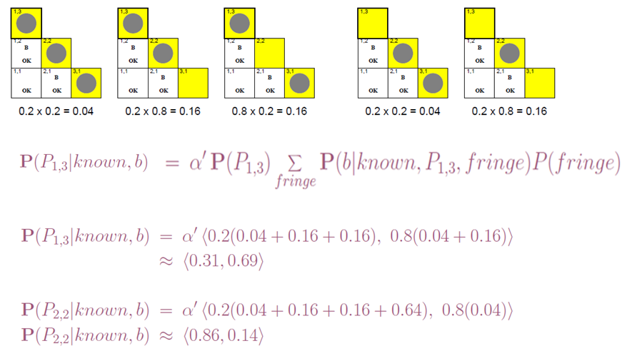
Using conditional independence contd.

Slide 68
Summary
Probability is a rigorous formalism for uncertain knowledge.
Joint probability distribution specifies probability of every atomic event (possible world).
Queries can be answered by summing over atomic events.
For nontrivial domains, we must find a way to compactly represent the joint distribution.
Independence and conditional independence provide the tools.
Notes:
Show in Aispace tool.

